Slide 2
Objectives
Explain the role of an IDE in writing program code and the common functions IDEs provide including:
Code editors
Run-time environment
Translators
Error diagnostics
Auto-completion
Auto-correction
Prettyprint

Slide 3
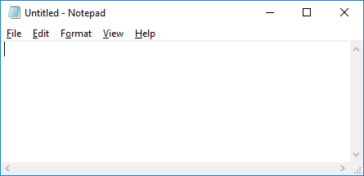
Starter
The simplest way to edit the source code to programs is to use a text editor such as Notepad
What problems are there with using such a simple text editor?

Slide 4
Starter
There are many problems that such a simple text editor has, including:
No line numbers
No syntax highlighting (colour coding of different parts of code)
No ability to run code directly inside the editor
No assistance in debugging code

Slide 5
IDEs
IDEs are Integrated Development Environments
They have a number of tools and features that help programmers when they are programming
Commonly used IDEs include Visual Studio (for C#, VB and other languages), Eclipse (for Java and many more) and IDLE (for Python)
What features do IDEs provide?

Slide 6
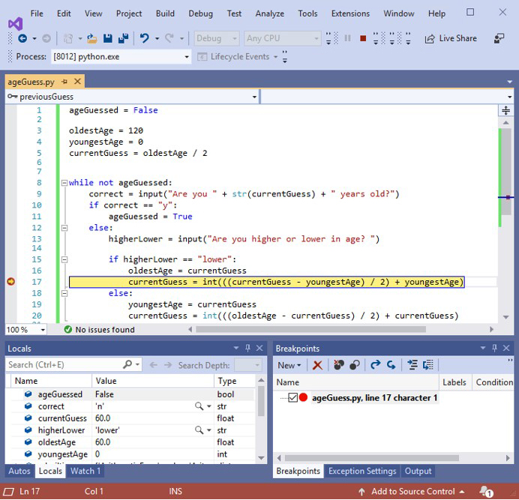
IDEs
Syntax highlighting
The following screenshot shows some of the features of an IDE
Explain what each of these features mean
Line numbers
Breakpoints
Code folding
Variable watching

Slide 7
Code editors
The editor provided in an IDE contains additional facilities to a basic text editor, such as:
Line numbers
Syntax highlighting
Prettyprint
Auto-completion
Auto-correction

Slide 8
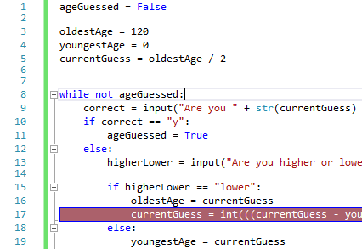
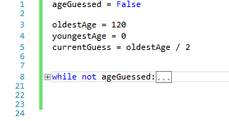
Line numbers
Line numbers allow a programmer to clearly see each new line of code
When errors are found, the line number that they occur on will also be stated
In some IDEs, parts of the program that the programmer doesn’t need to see can be folded
Notice the line numbers change where the code has been folded

Slide 9
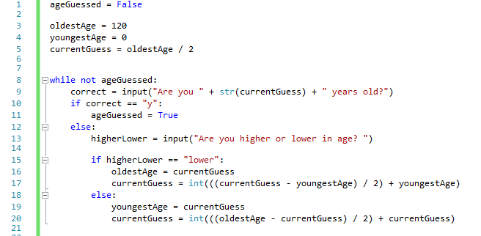
Syntax highlighting
Syntax highlighting is where the colour of the text changes to show different parts of the program
What do each of the colours mean below?

Slide 10
Syntax highlighting
 | Booleans (false, true), Keywords (while, not, if, else)
 | Type conversions (str, int)
 | Strings – e.g. "Are you higher or lower in age? "
 | All other operators, variables and functions names

Slide 11
Prettyprint
Prettyprint applies indentation and formatting to code
This makes it easier for other programmers to read
It also makes code consistent across different programmers
Original code
Code after Prettyprint
Class Main{public static void main(String[] args){system.out.println("Sum of 5 and 10"); int firstNum = 5; int secondNum = 10; int sum = first + second; system.out.println("Sum: " + sum);}}
Class Main
{
public static void main(String[] args)
{
system.out.println("Sum of 5 and 10");
int firstNum = 5;
int secondNum = 10;
int sum = first + second;
system.out.println("Sum: " + sum);
}
}
Prettyprint

Slide 12
Worksheet 5
Now complete Task 1 and Task 2 on Worksheet 5

Slide 13
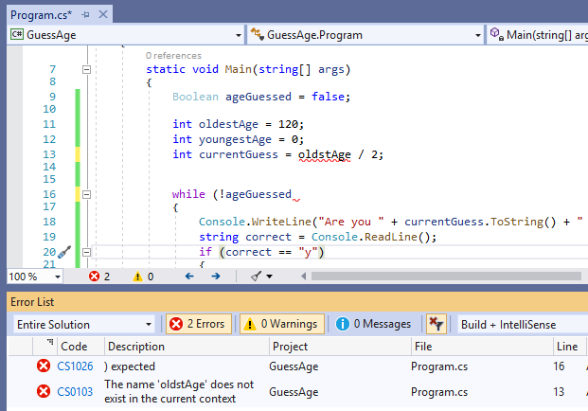
Error diagnostics
Error diagnostics help a programmer to find where they have made a mistake
Errors are identified along with the line number that they occur on
The code may be underlined or highlighted to show the error
This program is written C#
With the help of the error diagnostics fix the two errors shown

Slide 14
Error diagnostics
The errors show that:
A bracket needs to be added to the end of line 16
The variable oldstAge in line 13 doesn’t exist. The programmer should use oldestAge which they created in line 11

Slide 15
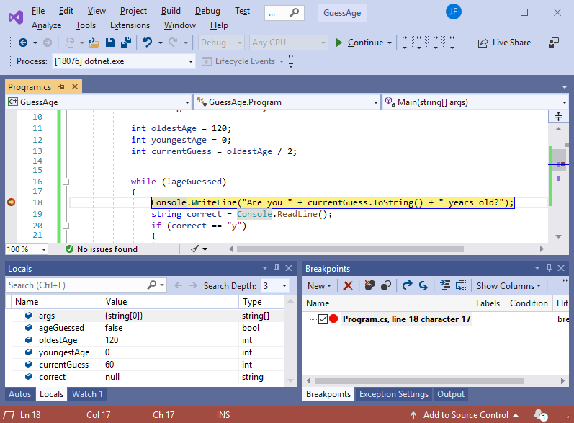
Debugging code
Breakpoints are set by the programmer so that the IDE stops the program mid-way through running
The programmer can the step through code line by line
They can watch variables as they change
The breakpoint was set to line 18
What do the variables contain at this point?

Slide 16
Variables
ageGuessed = false
oldestAge = 120
youngestAge = 0
currentGuess = 60
correct = null (it hasn’t yet been assigned a value)
args = {string[0]} These are arguments sent to the program when it is called

Slide 17
Run-time environment
The run-time environment allows a programmer to test their program while it is running
If the program crashes the run-time environment can see what happened and give useful information to the programmer
The run-time environment also means the libraries that come with the programming language will be available to the programmer to use

Slide 18

Translators
IDEs will contain the necessary translators to run and test the code
The IDE may compile the code or interpret it by running it line by line – this is very helpful when debugging the code
If the language is a compiled program, what actually happens when the ‘run’ program is pressed in the IDE?

Slide 19
Translators
For compiled languages, when the ‘run’ button is pressed the IDE will:
Compile the code in a temporary folder
Run the code

Slide 20
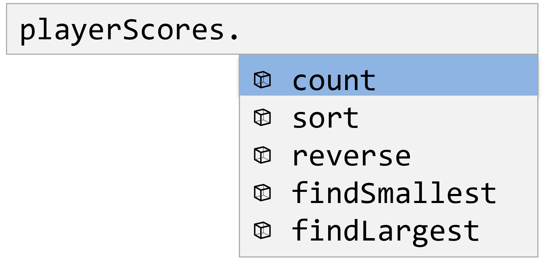
Auto-completion and correction
Auto-completion gives the programmer suggestions for variable names and keywords as they type
This may improve the speed that a programmer writes code
Tabs, brackets and braces may also be added automatically to the code to save the programmer time
Some IDEs have auto-correction which fixes mistakes such as those made in keywords
Some programmers may not like these tools as they could introduce a mistake to their code without them realising

Slide 21
Worksheet 5
Now complete Task 3 and Task 4 on Worksheet 5

Slide 22
Plenary
With a partner, take it in turns to explain each of the following terms related to IDEs:
Code editor
Run-time environment
Translators
Error diagnostics
Auto-completion
Auto-correction
Prettyprint

Slide 23
Plenary
Code editor – Use to write and edit programming code
Run-time environment – The facility of the IDE that allows programs to be run
Translators – Compilers and interpreters
Error diagnostics – A list of errors along with the line number in which they were detected
Auto-completion – A drop-down list of choices that will complete keywords or variables
Auto-correction – Correcting minor typing errors
Prettyprint – Altering indentation and formatting to make code easier to read

